Slide 1

GIS Mini-course:
Day 1: Review of Concepts and R Functions

Slide 2
Overview
Spatial Data Refresher
Loading and Cleaning Spatial Data in R
Basic Visualizations

Slide 3
1.1 The Spatial Analysis and GIS Landscape
In this mini-course, we will focus on how to work with spatial data in R, but note that spatial data, like tabular data, can be used and analyzed in many different software and data is interchangeable.
ESRI's ArcGIS
Paid, PC only, most tools out of the box
Quantum GIS or QGIS
Free, open-source, PC/MAC compatability
Geoda
Specifically designed for spatial statistics
Python
PostGIS (SQL)
Still others…

Slide 4
1.2 Types of Spatial Data
Vector
Raster
Vector data represents points, lines, and polygon geometries like cities, houses, streets, rivers, urban zones, census districts, etc.
Raster data represents continuous surface data in a regular grid and usually reflects environmental variables such as temperature, elevation, etc.
Notes:
There are two main types of spatial data: **Vector** and **Raster**.
We will not be using raster data here and will instead focus on vector data that can hold more than one attribute.

Slide 5
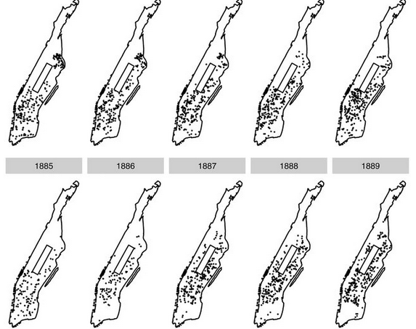
1.3 Vector Data
To the left, you can see an example of vector data. Both the rental observations (points) and Manhattan Island outline (polygon) are in vector format. They are mapped as overlapping layers.

Slide 6
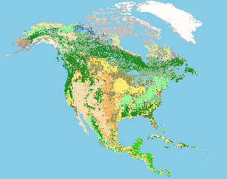
1.4 Raster Data
On the left is an example of raster data representing different dominate landcover types across North America. Each pixel holds a single integer value which corresponds to different land-cover types such as "grassland" or "water."
GLCC Land Cover Classification (North America)

Slide 7
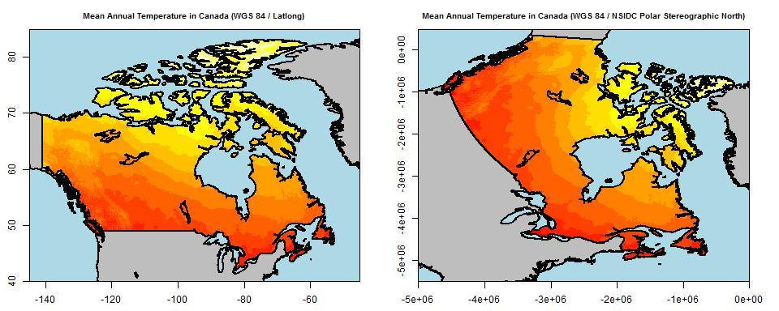
1.5 Coordinate Reference System
Spatial data are stored in various coordinate reference systems, which tells software how to draw the map to reduce distortion.
Not all systems use the same units!

Slide 8
2.0 Loading and Cleaning Spatial Data in R
Loading spatial data as a shapefile or as tabular data with coordinates attached is easy to do in R
We will be using the sf and rgdal packages
sf: Allows for reading, creation, and manipulation of "simple features" such as vector data
For more info: https://r-spatial.github.io/sf/articles/sf1.html
rgdal: Provides raster and CRS support (includes sp package)
For more info: https://cran.r-project.org/web/packages/rgdal/rgdal.pdf

Slide 9
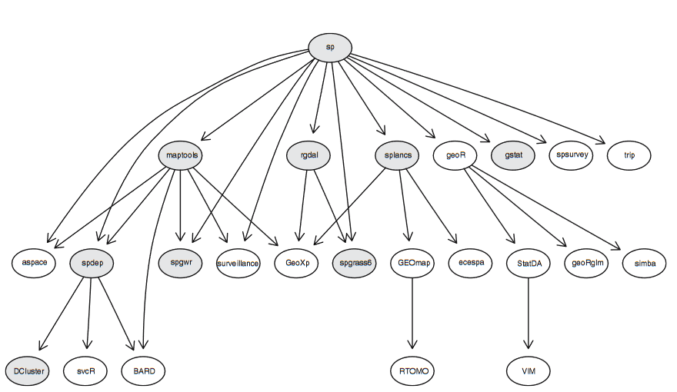

Slide 10

2.1 A Word about Data Organization
Data organization is important to find files easily but also to load them into R easier.
Setting a working directory will help
Hot Key Tip: Press Ctrl + Shift + H to manually select your working directory folder!

Slide 11
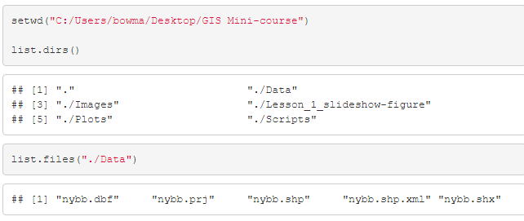
2.2 Looking into Directories
If I look inside my directory, now that it is set, I can see three sub-directories: Data, Plots, and Scripts.

Slide 12
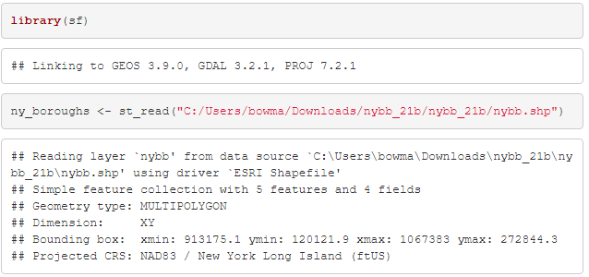
2.3 Loading and Cleaning Data in R
Using the sf package, we can read in a shapefile of New York City's boundaries. You can get the data here.

Slide 13
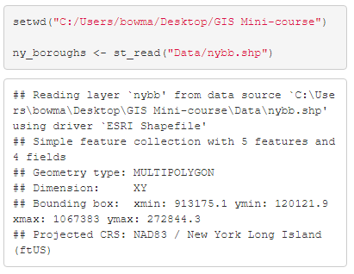
2.4 Using a Working Directory to Load Data
Pulling data from a working directory makes your job easier.
Only specify sub-directory then name of data

Slide 14
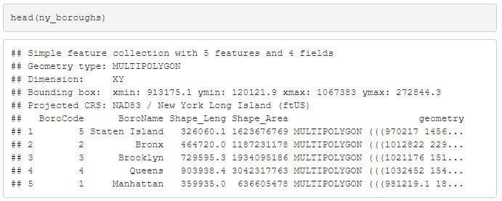
2.5 Data Structure of an sf Object
Spatial objects in R have a special column to describe the geometry of the vector.
For example, our New York City boroughs shapefile is a multipolygon (a polygon with multiple separate parts) with directions to draw the shape from vertex to vertex.

Slide 15
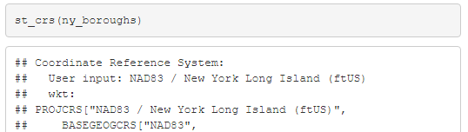

2.6 Checking Coordinate Reference System
Additionally, we can check the CRS of a loaded shapefile with sf's st_crs() function.

Slide 16
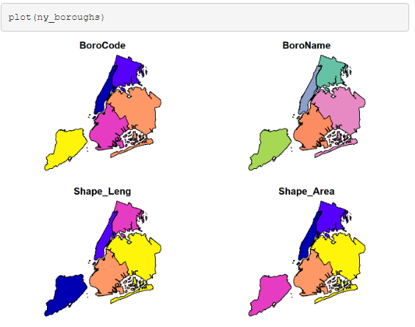
2.7 Simple Visualization using Base R
R will not automatically visualize the data like GIS software
Easiest way to visualize data is by using base R’s plot() function
By default, R will want to plot every variable which can be useful for exploration.

Slide 17
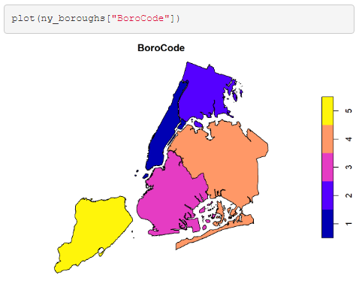
2.8 Specifying Plotting with Base R
You may also want to only plot one variable. You can do this by subsetting using brackets and a variable name.

Slide 18
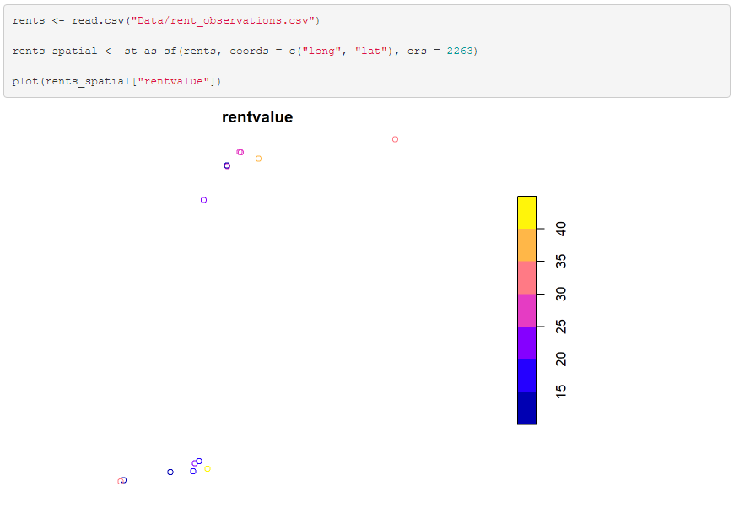
3.0 Converting Tabular Data to Spatial Data
The sf package can be used to convert tabular data with geometry info or coordinates into an sf object
Use st_as_sf() and specify which columns are longitude and latitude, and the CRS you want

Slide 19
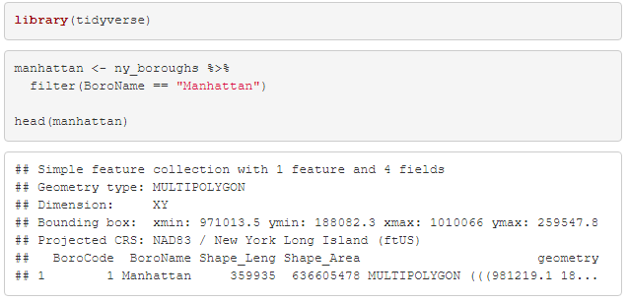
4.0 Subsetting Spatial Data
Subsetting spatial data can be done in much the same way you subset regular, tabular data. We will use the widely-used tidyverse package in this course.
If we only wanted to study Manhattan Island rather than all the boroughs of New York City we can use dplyr's filter() function.
Hot Key Tip: Press Ctrl + Shift + M to create a %>% or “pipe”

Slide 20
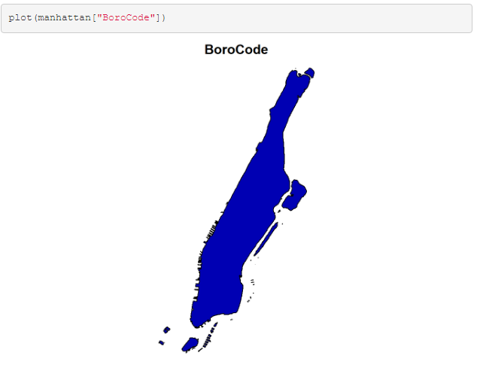

Slide 21
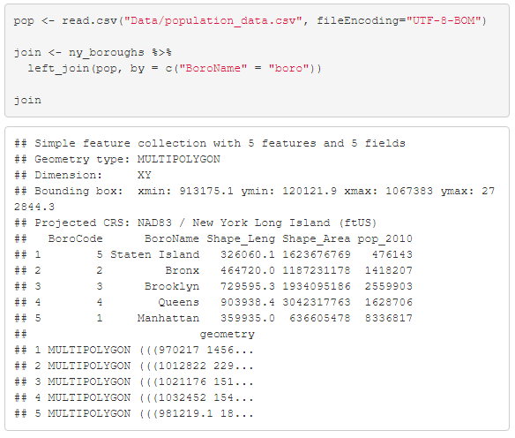
4.1 Joining Tabular Data to Spatial Data
Sometimes you will have tabular data and want to join it to a shapefile
We can, again, use tidyverse to join the tabular portions of the shapefile and spreadsheet data using left_join()
In this case, we have some population data at the borough level.
For more types of joins in tidyverse/dplyr see: https://dplyr.tidyverse.org/reference/join.html

Slide 22
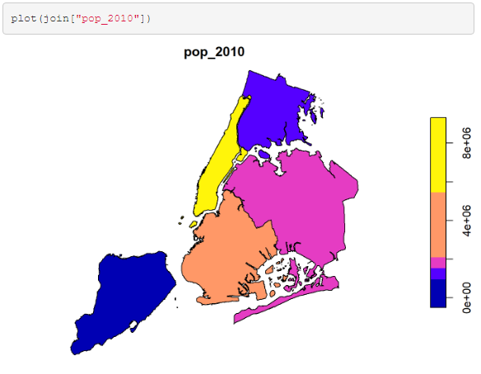

Slide 23
5.0 ggplot and tmap for Visualization
More control over plots can be gained through packages such as ggplot and tmap
Takes longer but better for customizing plots
Enables multiple overlays

Slide 24
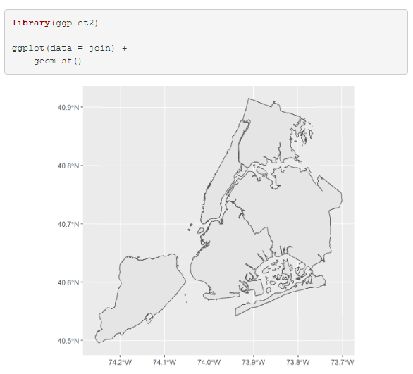
Ggplot Basics

Slide 25
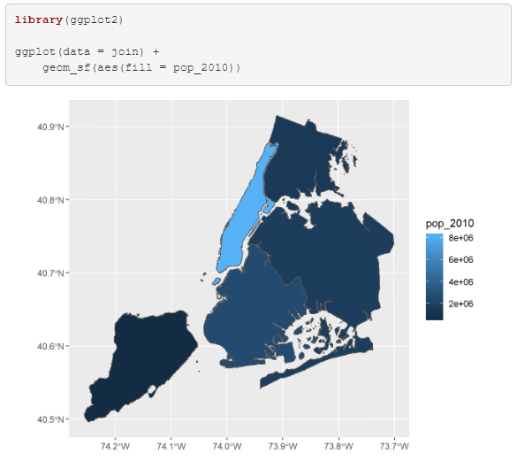
Ggplot with variable

Slide 26
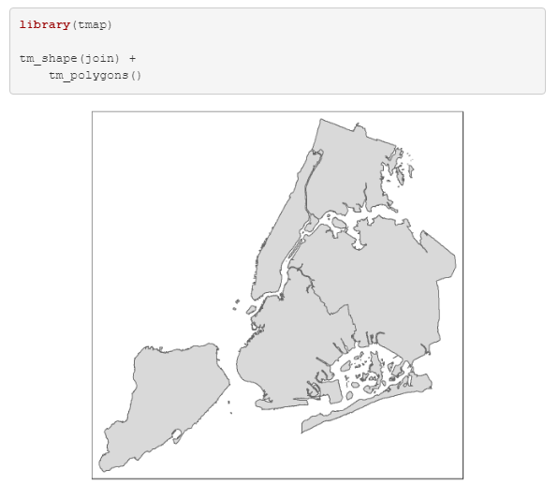
Basics with Tmap

Slide 27
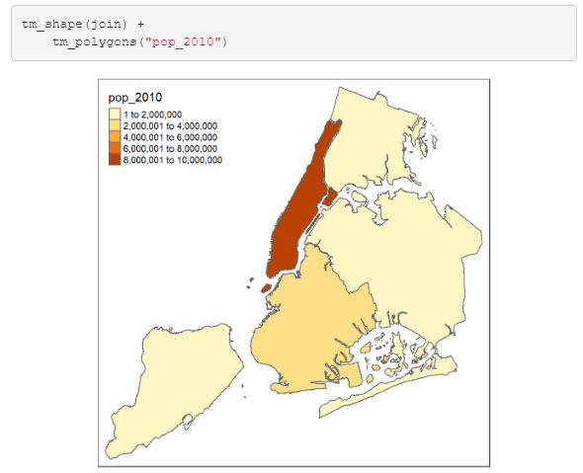
Tmap with variable

Slide 28
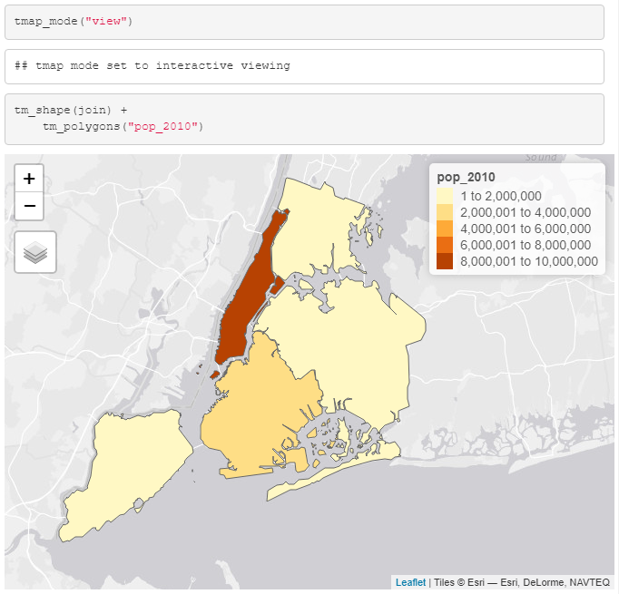
Tmap with leaflet interactive map

Slide 29
Now to practice

